Slide 1
LANDSCAPE RESILIENCE; CONCEPTS, SCORE & BASE LAYER OVERVIEW
DRAFT
Dan Wismer
Conservation Data Specialist
Last major edit: Oct 23rd, 2023

Slide 2
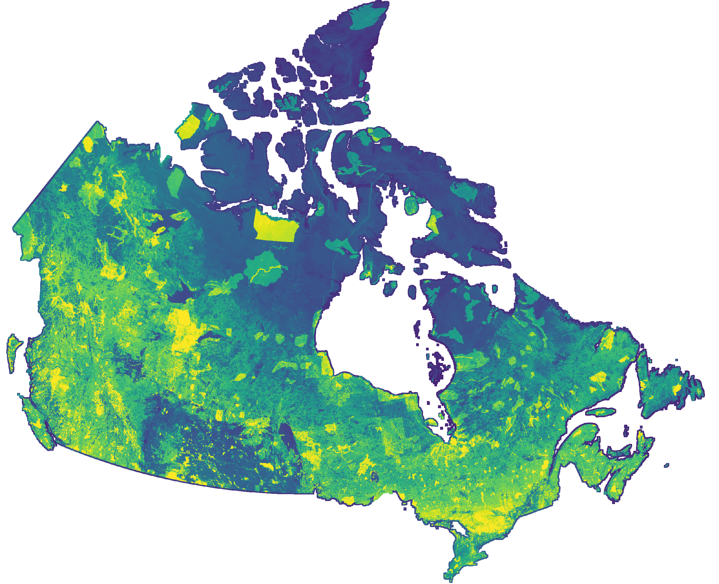
Objectives
Landscape Resilience
High Score
To provide an introduction on Landscape Resilience (why, what, how, and use case).
To overview the spatial data and equation used to generate the Landscape Resilience Score and Base Layer.
Low Score
Landscape Resilience Base Layer

Slide 3
Why Landscape Resilience?
To quantify Canada’s landscape using a single metric.
To increase planning efficiency with a centralized approach.
To align conservation efforts with the strategic plan (optimize delivery and accelerate conservation) and evaluate impact.
To link Connectivity, Adequacy, Representatives and Efficiency principles to the landscape (C.A.R.E.).
To provide basis for directing limited resources to those areas on the landscape where they are likely to have the greatest benefit.

Slide 4
What is Landscape Resilience?
Landscape Resilience* is an area of land marked with the combination of biodiversity and diverse, connected habitat that enables species to persist and adapt to environmental pressures over time.
Landscape Resilience Score is the result of combining ecological variables that address protection, biodiversity, connectivity, climate, habitat, and threats at the landscape scale.
NCC measures Landscape Resilience at the 1km x 1km pixel scale using the Landscape Resilience Score. Each pixel makes up the Landscape Resilience Base Layer.
* NCC’s interpretation of resilience. See appendix and reference slides for academic literature definitions.

Slide 5
How will Landscape Resilience be Used?
To support landscape scale conservation planning
To set priorities at the Canada-wide scale and provide a case for conservation.
To help identify unprotected resilient areas as candidates for area-based conservation.
To help identify degraded areas as candidates for restoration.
To quantify a projects contribution to increasing Landscape Resilience.
Areas with high Landscape Resilience Scores implies protection, biodiversity, connectivity climate and habitat are well met with minimized threats.

Slide 6
What Drives Landscape Resilience?
Themes
Variables
Protection: existing conservation
Biodiversity: richness, adequacy, key biodiversity areas, SAR critical habitat
Climate: centrality, refugia
Connectivity: current density
Habitat: forest, wetland, grassland, rivers, shoreline
Threats: human disturbance, climate extremes

Slide 7
Landscape Resilience Inputs
Protection
Protected areas contribute to Landscape Resilience by safeguarding species from threats of biodiversity loss.
Variables that capture Protection:
Existing conservation from Canadian Protected and Conserved Areas Database
This includes NCC fee simple and conservation agreement achievements not in CPCAD
All protected area classes are considered equal

Slide 8
Landscape Resilience Inputs
Biodiversity
Biodiversity theme is captured by mapping species richness and calculating protection goals for each species. Individual goals are then summed into a single cumulative adequacy goal.
The cumulative adequacy goal explains the required protection needed to ensure species persistence throughout time; where some species need more conservation than others (Rodrigues et al, 2004).
Variables that capture Biodiversity:
Species at risk: richness & cumulative adequacy goal (ECCC)
Endemic species: richness & cumulative adequacy goal (NSC)
Common species: richness & cumulative adequacy goal (IUCN & NSC)
Key biodiversity areas (KBA Canada & Birds Canada)
SAR Critical habitat for species at risk (ECCC)

Slide 9
Landscape Resilience Inputs
Climate
Related to connectivity, it is important to adjust for the effects of climate change and give species the opportunity to move as climate conditions change.
Many species will be facing conditions beyond their ability to survive by 2100 and will need to shift to more suitable environments to persist (Karen et al, 2023)
Variables that capture Climate:
Climate refugia (Stralberg et al. 2021; AdaptWest)
Locations with rare climatic conditions that are likely to facilitate species persistence under climate change
Climate centrality (Carroll et al. 2018; AdaptWest)
Represents connectivity between current and future climate analogs

Slide 10
Landscape Resilience Inputs
Connectivity
Landscapes that are connected promote the movement of species among habitat patches
High connectivity values favor biological flows and represent movement and dispersal patterns of species.
Variables that capture Connectivity:
Current density (Pither et al, 2023)
Considered anthropogenic and natural features and their known effects on the movement of terrestrial non-volant fauna to predict connectivity.

Slide 11
Landscape Resilience Inputs
Habitat
By securing a diverse portfolio of habitat types ensures redundancy is built into the protected area network.
Habitat types reflect NCC impact metrics.
Variables that capture Habitat:
Forest landcover hectares (VLCE2 and AFFC LUTS)
Wetland hectares (CanVec)
Grassland hectares (AAFC LU)
Rivers kilometers (NRCan)
Shoreline kilometers (CanVec)

Slide 12
Landscape Resilience Inputs
Threats
Habitat pressures pose a negative impact on Landscape Resilience.
Variables that capture Threats:
Human footprint index (Hirish-Pearson et al, 2021)
considers built environments, population density, nighttime lights, crop lands, pasture lands, forestry, railways, roads dams, reservoirs, navigable waterways, mining and oil and gas disturbances.
Climate extremes (La Sorte et al. 2021)
Useful way to capture extreme stressors on biodiversity

Slide 13
Landscape Resilience Equation
Landscape Resilience Score =
protection +
key biodiversity areas + SAR critical habitat + SAR richness + END richness +
common richness + SAR goal + END goal + common goal +
connectivity +
climate centrality + climate refugia +
forest landcover + wetland + grassland + rivers + shoreline
- human footprint index - climate extremes
CP&P recommends all variables to be equal (no weights).

Slide 14
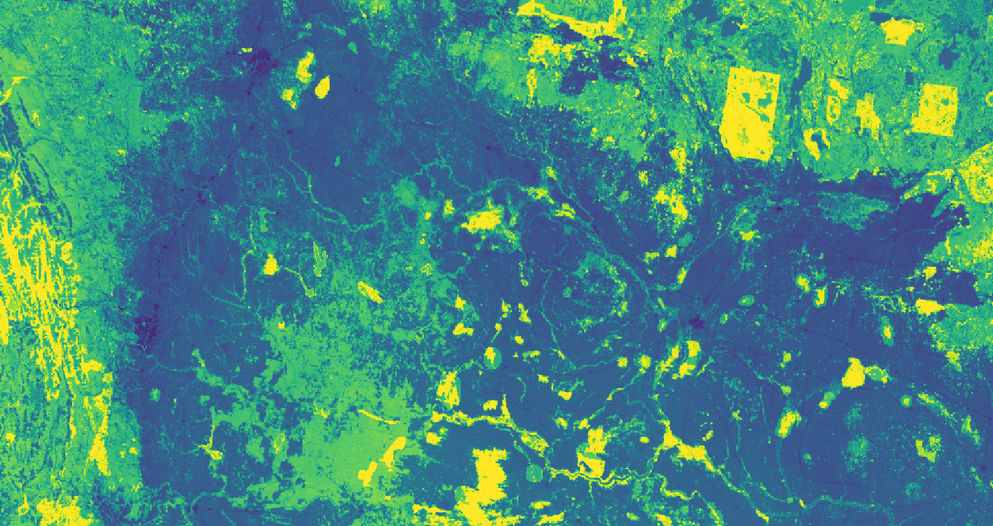
Landscape Resilience Output
Landscape
Resilience
Edmonton
High Score
Low Score
Each pixel has a score.
All pixels make up the base layer.
Calgary
Saskatoon

Slide 15
Output Interpretation
An area that has a high Landscape Resilience Score is protected, with a varied combination of biodiversity, connectivity climate and habitat with minimized threats.
An area with a low Landscape Resilience Score is unprotected, with a varied combination of low biodiversity, unconnected, poor climate resilience and limited and threatened habitat.
Protecting intact areas with moderate Scores will improve Landscape Resilience.
Sask.
Landscape
Resilience
Edmonton
High Score
Low Score
Moose Mtn. Prov. Park
Calgary
Saskatoon

Slide 16
Limitations
Ambiguity in definitions and lack of quantification
Omitting the comparison between current landscape to a historical range of variation
Omitting threshold definitions that indicate when a landscape loses ecological memory
No data to support habitat attributes such as a quality
Difficult to capture small area-based conservation’s contribution to Landscape Resilience when rolled-up to the 1km scale
Difficult to capture site-level reclamation project’s contribution to Landscape Resilience when rolled-up to the 1km scale
No temporal analysis post reclamation
Variable selection was based on “expert” opinion (no statistically significant testing)
No ground truthing of base layer (could not find real world sites?)
Omitting ecological resilience concept in terms of disturbance and bounce-back

Slide 17
Appendix
Landscape Resilience - What's in the academic literature?
For a landscape to be resilient, it must be able to adapt to pressures over time in a way that supports the long-term survival of biodiversity and ecosystems.
Landscape Resilience retains “ecological memory” & connectivity among neighboring systems post disturbance; avoiding regime shifts at broad spatial extents.
Ecological Resilience is the main term, followed by other variations (ex. spatial resilience).
When the resilience of an ecological system is exceeded, ecosystems enter a new local equilibrium that differs in structure and function from the previous state (Craig et al, 2016).
Resilience is the ability to recover once a disturbance ends. Resistance is the ability to persist or withstand a disturbance (Strickler, 2022).

Slide 18
Appendix
Landscape Resilience Score Details:
Each variable is scaled between 0 and 1 before the score is executed. This step is required to combine features that have different units of measurement.
Scaling equation:
Normalized feature = (feature – min value) / ( max value – min value)

Slide 19
References
Ecological Resilience, Biodiversity and Scale
https://link.springer.com/article/10.1007/s100219900002
Resilience and stability of ecological systems:
https://www.annualreviews.org/doi/abs/10.1146/annurev.es.04.110173.000245
Metrics and Models for Quantifying Ecological Resilience at Landscape Scales:
https://www.frontiersin.org/articles/10.3389/fevo.2019.00440/full
Wild, connected, and diverse: building a more resilient system of protected areas:
https://esajournals.onlinelibrary.wiley.com/doi/full/10.1002/eap.1527
Understanding protected area resilience: a multi-scale, social-ecological approach:
https://esajournals.onlinelibrary.wiley.com/doi/abs/10.1890/13-2113.1?casa_token=a5GUcC01mnsAAAAA:dsV4tSiXnHfhPwnCutvAEmA-FGFrxO40JND730ft-nI6Oq_Eqe6GlarmzasTqznSmhyP1B2BW-0UNNg5
Landscape ecological concepts in planning: review of recent developments:
https://link.springer.com/article/10.1007/s10980-021-01193-y
Managing Rather Than Avoiding “Difficulties” in Building Landscape Resilience:
https://www.mdpi.com/2071-1050/13/5/2629
Quantifying spatial resilience:
https://besjournals.onlinelibrary.wiley.com/doi/full/10.1111/1365-2664.12634
Resilience in the Studies of Biodiversity-Ecosystem Functioning:
https://www.cell.com/trends/ecology-evolution/fulltext/S0169-5347(15)00321-3
Perspectives for ecosystem management based on ecosystem resilience and ecological thresholds against multiple and stochastic disturbances:
https://www.sciencedirect.com/science/article/pii/S1470160X15002411
A riparian conservation network for ecological resilience:
https://www.sciencedirect.com/science/article/pii/S0006320715002529#bb0155
A resilient and connected network of sites to sustain biodiversity under a changing climate
https://www.pnas.org/doi/10.1073/pnas.2204434119
Biodiversity, ecosystem function, and resilience: ten guiding principles for commodity production landscapes
https://esajournals.onlinelibrary.wiley.com/doi/full/10.1890/1540-9295%282006%29004%5B0080%3ABEFART%5D2.0.CO%3B2?casa_token=iSM4aLrMYhcAAAAA%3A7vbR7SrZmxu_f3k5FDiNeRWU9icdsIW24OMs6uA9QyAp6uCxU-JiKypg2ox7W9UpNIh2NCDROQtxkV4l
Ecological Resilience and Resistance
https://www.thesciencewriter.org/resilience-stories/ecological-resilience-and-resistance
Enabling a National Program for Ecological Corridors in Canada
Enabling a National Program for Ecological Corridors in Canada in support of biodiversity conservation, climate change adaptation, and Indigenous leadership – ScienceDirect

Slide 20
LANDSCAPE RESILIENCE BUILDER THIS IS NOT THE LANSCAPE RESILIENCE TOOL
Dan Wismer
Conservation Data Specialist
Last major edit: Sep 28th, 2023

Slide 21
Landscape Resilience Builder
Designed as an engagement tool that shows transparency in the make-up of the Landscape Resilience (LR) Score.
Provides a proto-type of Landscape Resilience, where each pixel has a score
Users can change values and update the LR score in real time. This provides a means to reason with the relative importance of layers that comprise the score. Note: CP&P Recommends all weights are equal and set at 1.
Go to Builder

Slide 22
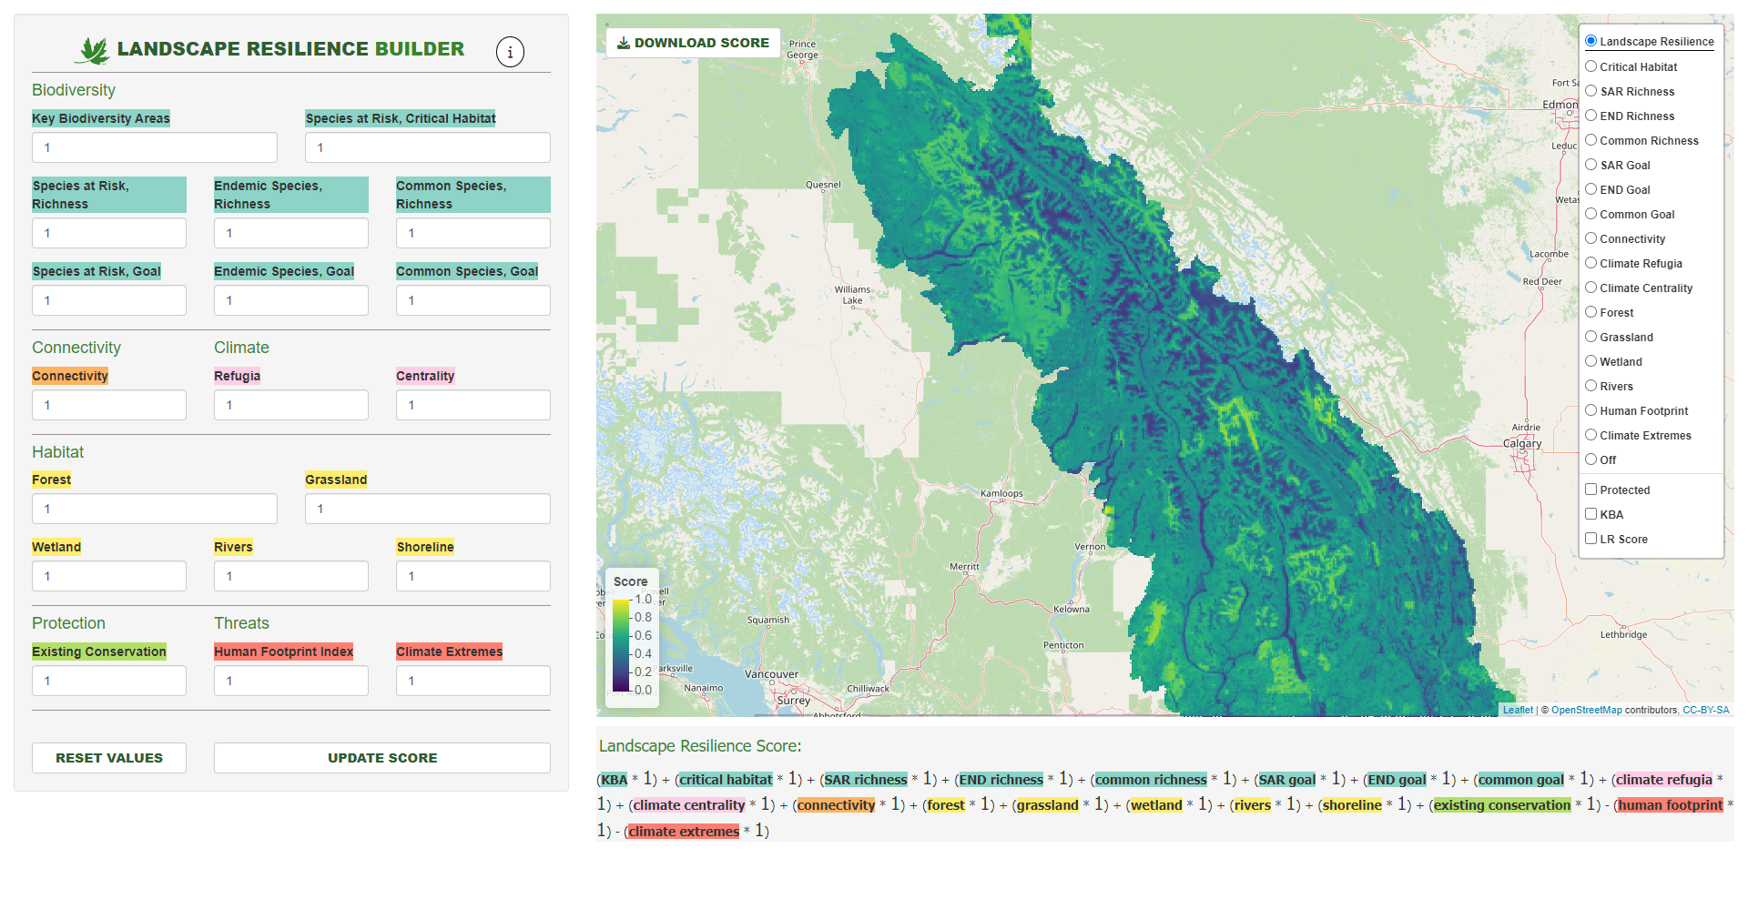
Landscape Resilience Builder
Download score (.tif) and values (.xlsx)
PowerPoint
Web link
View layers one at a time
Update values
Toggle overlays
Legend
Click points to view LR Score
Landscape Resilience Equation
Reset values
Update score on map

